Slide 1
IIFB Positions on DSI
July 2, 2024

Slide 2
Convention on Biological Diversity 1992
Started in 1987 with United Nations Environmental Program
Ad Hoc Working Group of Experts on Biological Diversity
Started as a “nature conservation” negotiation
Brundtland report (1988): Introduced sustainable development and added humans into the picture

Slide 3
Convention on Biological Diversity 1992
UN General Assembly resolution: "Sovereignty over Natural Wealth and Resources” (1952)
Genetic resources (GRs): Common Heritage of Mankind (global public domain)
Concern over biopiracy – lack of consent and benefit sharing
CBD: Genetic resources brought under national sovereignty framework

Slide 4
CBD definition of GRs and derivatives
Genetic resources: Genetic material of actual or potential value. (Article 2, CBD)
Genetic material: Any material of plant, animal, microbial or other origin containing functional units of heredity. (Article 2, CBD)
Utilization of genetic resources: CBD mentions but does not define, links to application of biotechnology
Nagoya Protocol Article 2: conduct of research and development on the genetic and/or biochemical composition of genetic resources, including through the application of biotechnology as defined in Article 2 of the Convention

Slide 5
CBD definition of GRs, utilization, and derivatives
Genetic resources: Genetic material of actual or potential value. (Article 2, CBD)
Genetic material: Any material of plant, animal, microbial or other origin containing functional units of heredity. (Article 2, CBD)
Utilization of genetic resources: conduct of research and development on the genetic and/or biochemical composition of genetic resources, including through the application of biotechnology as defined in Article 2 of the Convention (Article 2, Nagoya Protocol)

Slide 6
UN Declaration on the Rights of Indigenous Peoples (UNDRIP)
Article 31 – Indigenous Peoples have the right to control access to their traditional knowledge and genetic resources
Genetic resources are not defined in UNDRIP
Article 31 drafted late in process, by Indigenous negotiators participating in the World Intellectual Property Organization (WIPO IGC) and the CBD
Understanding of scope of genetic resources the same as in CBD and WIPO IGC.

Slide 7
Convention on Biological Diversity 1992
Article 8(j):
Each contracting Party shall, as far as possible and as appropriate:
Subject to national legislation, respect, preserve and maintain knowledge, innovations and practices of indigenous and local communities embodying traditional lifestyles relevant for the conservation and sustainable use of biological diversity and promote their wider application with the approval and involvement of the holders of such knowledge, innovations and practices and encourage the equitable sharing of the benefits arising from the utilization of such knowledge innovations and practices.

Slide 8
Convention on Biological Diversity 1992
Article 8(j) only covers rights over traditional knowledge, innovations and practices, NOT genetic resources
Uses phrase “indigenous and local communities” (ILCs): Changed to indigenous peoples and local communities” in 2014
“Approval and involvement” of ILCs
Only addressed “equitable sharing of benefits” – not control over uses

Slide 9


IP&LC concerns over GRATK
IK TK
BIOPIRACY
IK/TK
IK/TK
GRs
IP or LC
Lands, Waters,
Territories
IK TK

Slide 10

Main case of CBD
$$$$
IPLCs
Corporate
research
Relations
Kinship
Biological
sample
Institutional research
Non-IPLCs
contains GRs
University research
Resources

Slide 11





8(j) model of GRs and associated traditional knowledge
TK as a lead to useful gene-influenced traits

Slide 12
Legal and Soft Law (Voluntary) Frameworks for Implementing Benefit Sharing and 8(j)
Framework for implementing national sovereignty and 8(j)
COP IV/8 and COP IV/15 para 10 (Bratislava, 1998)
Bonn Guidelines (2002)
Working Group on Access and Benefit Sharing (2001-2010)
Nagoya Protocol (2010) (2024: 141 ratifications)
Voluntary frameworks necessary, as many countries have not ratified NP (2024: 57)

Slide 13



Nagoya Protocol (2010) Model
Bilateral agreement /
Contract
Results in commercial product and benefit sharing with provider
Work on single sample of GRs in lab

Slide 14
Nagoya Protocol
Contracts between 2 parties (bilateral) for access to GRs and traditional knowledge (GRATK)
TK always requires PIC (Article 7)
GRs requires PIC/A&I only if IP&LC rights recognized by states
Article 6 para 2: In accordance with domestic law, each Party shall take measures, as appropriate, with the aim of ensuring that the prior informed consent or approval and involvement of indigenous and local communities is obtained for access to genetic resources where they have the established right to grant access to such resources.

Slide 15
Nagoya Protocol (2010) Model
One-on-one negotiation is based on prior informed consent based on mutually agreed terms (PIC and MAT) for access to traditional knowledge associated with genetic resources
Genetic resources (samples taken from IP or LC lands) only require PIC and MAT if country recognizes it
Contracting into custom: Cultural/biocultural protocols) can be used in bilateral agreement to allow control over benefit sharing AND uses

Slide 16
Nagoya Protocol (2010) Model
Although Nagoya encourages benefits to biodiversity, it is not required – it can be just monetary benefit sharing. It is a private contract.
Recognition of rights to PIC and MAT to GRs and associated TK a big win, even though imperfect
Value at the collection stage is low, even with TK. Value only realized if a successful product is developed (1 in 10,000 samples)
Hard to measure benefits. Access and Benefit Sharing Clearinghouse lists over 4,000 ABS contracts, most from India.

Slide 17
TK protected anywhere, GRs MAY by protected
IK TK
Rights to GRs only recognized if states recognize IP or LC them
Generally only for samples taken directly from IP or LC lands
Ancestral Domain
Current Territory
Most states treat ancestral domain as under state sovereignty
with no rights to GRs

Slide 18
DSI adds to the complexity and challenges of the ABS / NP model
ABS and NP don’t deal with technical issues at the genome level
Legal treatment of biological samples relatively straightforward
  Owner of sample taken from lands, waters and territories has dominant control over terms of MAT of what can be done with sample containing GRs, regardless of genetic structure and dynamics
Moving from Newtonian genetics to quantum genetics

Slide 19
It is (relatively) easy to divide bodies of animals and plants

Slide 20

Samples containing DNA (relatively) easy to control as a sample wholly under control
Associated TK
IPLC Territory
+ Associated TK

Slide 21
Advances in Genetics
Big data, high-throughput analysis using 10-100+ samples, artificial intelligence, synthetic biology – do not use single samples
Clustered regularly interspaced short palindromic repeats (CRISPR)
World Health Organization (WHO): pre-Covid problems with virus sharing
Food and Agriculture Organization of the United Nations (FAO)
International Treaty on Plant Genetic Resources for Food and Agriculture (ITPGRFA) (2001)

Slide 22
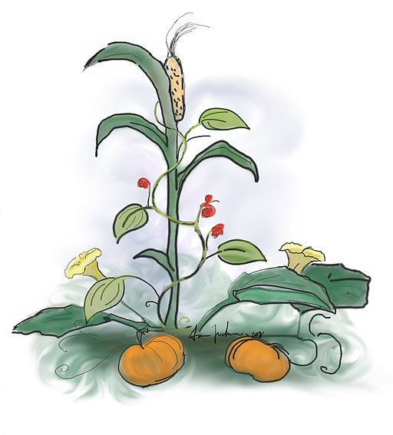

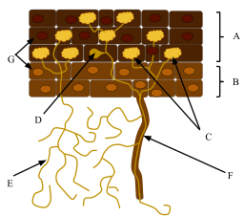
Omics - not just a single genome metagenomics, transcriptomics, metabolomics, proteonomics, microbiomics, environmental DNA – not simply sequence information
Three Sisters indigenous cultivation system
wild crop companions
Bacteria and mycorrhiza (fungi) genomes involved in nitrogen fixation
Mycorrhiza genomes involved in nutrient and energy transfer
Microbiomes in the soil, on leaves and stems
Symbiomes / Anthromes

Slide 23
Challenges to gene sovereignty regime
Patents are granted for novel, non-obvious and inventive steps. Naturally occurring genes generally not patentable: no intellectual property.
Naturally occurring genes in many states cannot be patented, as they are naturally occurring products of nature.
“Wild” biodiversity, crops and breeds, and human genes under different regimes (but share many gene sequences).
Data sovereignty of IPs and LCs difficult to apply – only control of data generated on IP or LC territories.

Slide 24
End Day 1

Slide 25
Digital Sequence Information (DSI)
Most gene sequences are shared very widely within and between species
No control over natural species, seed, pollen movement
Difficulty identifying what is unique to a territory:
Even if a species is endemic to a territory, most genes are not (but some are)
Species and genes migrate: off of and onto LC lands, waters and territories
Trillions of small gene sequences already out there

Slide 26
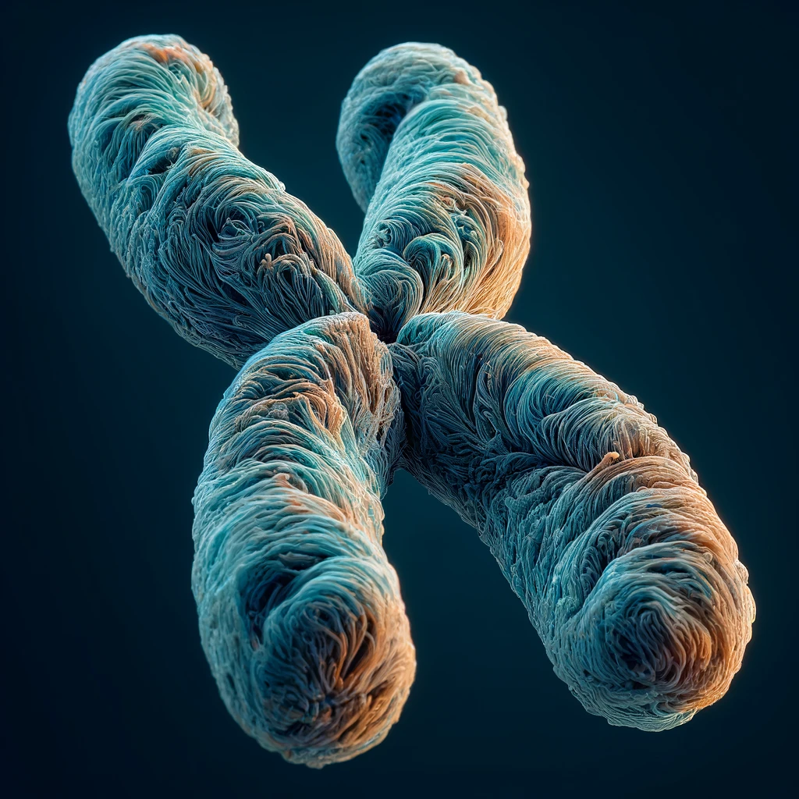

Drawings of Chromosomes

Slide 27
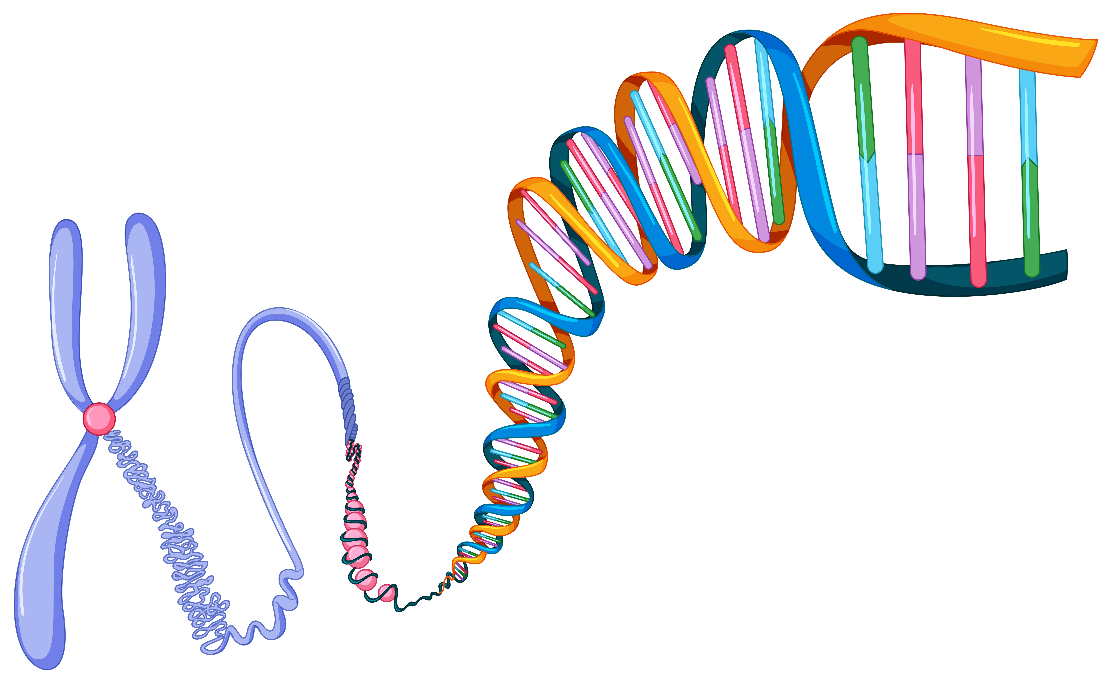
Drawings of Chromosomes
https://www.vecteezy.com/free-vector/chromosome - Chromosome Vectors by Vecteezy

Slide 28
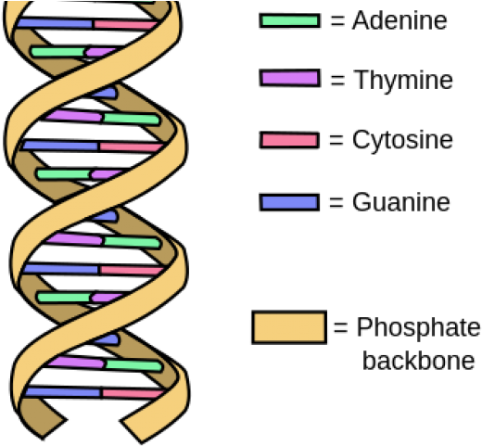
DNA: 4 nucleotides, 2 base pairs

Slide 29
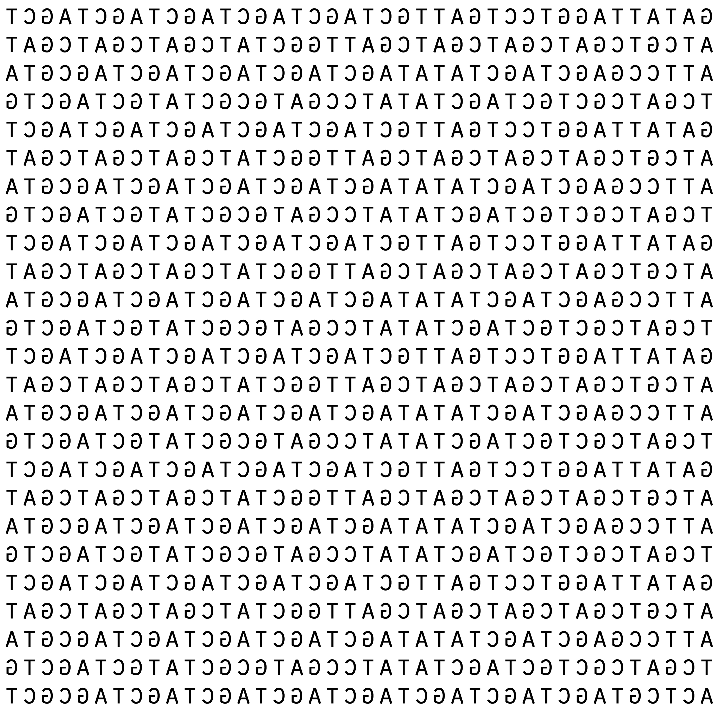
D
S
I

Slide 30
Unique genes small % of genome
Taxonomic Group | Range of Number of Nucleotides | Range of Number of Genes
Vertebrates | 3 billion to 6 billion | 20,000 to 30,000
Invertebrates | 100 million to 3 billion | 10,000 to 50,000
Plants | 100 million to 10 billion | 20,000 to 50,000
Bacteria | 0.5 million to 10 million | Few hundred to 10,000
Nucleotide: a compound consisting of a nucleoside linked to a phosphate group. Nucleotides Nucleotide: a compound consisting of a nucleoside linked to a phosphate group. Nucleotides form the basic structural unit of nucleic acids such as DNA.
Gene: a distinct sequence of nucleotides forming part of a chromosome, the order of which determines the order of monomers in a polypeptide or nucleic acid molecule which a cell (or virus) may synthesize

Slide 31
Genes widely shared within and between species
99.8% chimpanzees
80% bears
60% salmon
40% insects
24% wine grapes

Slide 32
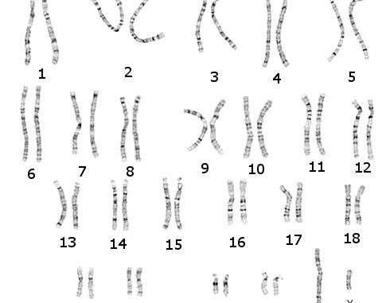
Unique genes small % of genome

Slide 33
Natural forms of gene migration and recombination
CBD and NP center on biopiracy and misappropriation from lands, waters and territories (“territorial model”)
Genetic material moves naturally: dispersal, migration, movement of spores and pollen, sexual reproduction, sexual recombination, hybridization, horizontal gene transfer, etc.
Movement occurs in every direction – into and out of territories. Makes determination of purely sovereign gene sequences exceedingly difficult, and undercuts sovereignty claims, or triggers competing sovereignty claims

Slide 34
Gene Flow: Pollen, Seeds, Migration
IP or LC Territory
+ Associated TK

Slide 35
Many origins, many jurisdictions
Farmland
National Park
Mesoptomaia
Pangeia
Ancestral
Domain
Pandora
collections

Slide 36
Challenges to gene sovereignty regime
Ancestral domain
treated differently by
different states – most
usual as under state
sovereignty
Ancestral Domain
Current Territory
Ceded, stolen or otherwise
occupied lands now claimed
as under state sovereign
jurisdiction

Slide 37
Challenges to gene sovereignty regime
Patents are granted for novel, non-obvious and inventive steps
Naturally occurring genes in many states cannot be patented, as they are naturally occurring products of nature
“Wild” biodiversity, crops and breeds, and human genes under different regimes (but share many gene sequences)

Slide 38
Global Multilateral Benefit-Sharing Mechanism GMLBSM
DB Deposit Requirements
[origin]
Hybrid Approach
Nagoya
FPIC & MAT
Principles of data governance (ORDG)
Funds distributed as projects
F&E IP & LC Participation in Governance
Fair distribution
of projects
New genetic materials acquired from IP or LC territories or collections form these lands under Nagoya
Triggers
following digitalization
Raising funds
Researchers
1% on commercial sales
Voluntary contributions
endemic
species
genes
Non-monetary Benefits

Slide 39
Brief review of decision 15/9
Very sensitive political decision made in COP 15/ to establish mechanism
Strong debate over whether DSI is part of the mandate of the CBD treaty
DSI is information, not a physical genetic resource and therefore not a use of a GR
Politically sensitive because many Parties are not supportive
Observers were shut out from much of the process due to political sensitivity
15/9 paragraphs 6-11 represent the political compromise:
Agreed digital sequence information is part of the CBD as a utilization of GRs
In return, strict conditions were put on the fund-raising mechanism:
Effective, more benefits than costs, not interfere with research

Slide 40
Brief review of decision 15/9
IIFB was able to get five elements into the decision:
Preamble text (history, purposes, aspirations, interpretations and guidance)
Research principles that address openness and access to data (FAIR Principles)
Research principles that respect for cultural rights and values (CARE Principles)
Operational text (binding agreement)
Paragraph 10: Throughout negotiations IPs and LCs “primary beneficiaries”
“Primary” was deleted, but IPs and LCs only named beneficiaries
Many Parties still support most benefits should go to IPs and LCs on the ground
Paragraph 11: . . . . decision does not affect existing rights and obligations under the Convention and the Nagoya Protocol, including, as applicable, those related to traditional knowledge and the rights of indigenous peoples and local communities, and is without prejudice to national access and benefit-sharing measures;

Slide 41
Brief review of decision 15/9
Appendix (parking lot, undecided)
(m) Role, rights and interests of indigenous peoples and local communities, including associated traditional knowledge;
(p) Principles of data governance.

Slide 42
Kunming-Montreal Global Biodiversity Framework (KMGBF)
GOAL C
The monetary and non-monetary benefits from the utilization of genetic resources and digital sequence information on genetic resources, and of traditional knowledge associated with genetic resources, as applicable, are shared fairly and equitably, including, as appropriate with indigenous peoples and local communities, and substantially increased by 2050, while ensuring traditional knowledge associated with genetic resources is appropriately protected, thereby contributing to the conservation and sustainable use of biodiversity, in accordance with internationally agreed access and benefit-sharing instruments.
Decision 15/9: Digital sequence information on genetic resources
9-11: Core elements and Annex (parking lot)

Slide 43
End Day 2

Slide 44
Global Multilateral Benefit-Sharing Mechanism GMLBSM
DB Deposit Requirements
[origin]
Hybrid Approach
Nagoya
FPIC & MAT
Principles of data governance (ORDG)
Funds distributed as projects
F&E IP & LC Participation in Governance
Fair distribution
of projects
New genetic materials acquired from IP or LC territories or collections form these lands under Nagoya
Triggers
following digitalization
Raising funds
Researchers
1% on commercial sales
Voluntary contributions
endemic
species
genes
Non-monetary Benefits

Slide 45
Kunming-Montreal Global Biodiversity Framework (KMGBF)
Preambular text
para 6: Reaffirms its expectation that Parties and other Governments will ensure that the rights of IPLCs are respected and given effect to in the implementation of the KMGBF;

Slide 46
Kunming-Montreal Global Biodiversity Framework (KMGBF)
Operational text (Decision text)
Section C. Considerations for the implementation of the Framework
Contribution and rights of IPLCs, subpara a:
Acknowledges roles and contributions of IPLCs to biodiversity and its restoration
Implementation must ensure that the rights, knowledge, including traditional knowledge associated with biodiversity, innovations, worldviews, values and practices of indigenous peoples and local communities are respected

Slide 47
Kunming-Montreal Global Biodiversity Framework (KMGBF)
Operational text (Decision text)
Documentation and preservation requires free, prior and informed consent
Ensure full and effective participation in decision-making, in accordance with relevant national legislation, international instruments, including the United Nations Declaration on the Rights of Indigenous Peoples, and human rights law
nothing in this framework may be construed as diminishing or extinguishing the rights that indigenous peoples currently have or may acquire in the future (non-regression clause)

Slide 48
Kunming-Montreal Global Biodiversity Framework (KMGBF)
Operational text (Decision text)
Human rights-based approach
para g:
respecting, protecting, promoting and fulfilling human rights
human right to a clean, healthy and sustainable environment;

Slide 49
Kunming-Montreal Global Biodiversity Framework (KMGBF)
Section G. Global goals for 2050 (A-D)
GOAL C
The monetary and non-monetary benefits from the utilization of genetic resources and digital sequence information on genetic resources, and of traditional knowledge associated with genetic resources, as applicable, are shared fairly and equitably, including, as appropriate with IPLCs, and substantially increased by 2050, while ensuring traditional knowledge associated with genetic resources is appropriately protected, thereby contributing to the conservation and sustainable use of biodiversity, in accordance with internationally agreed access and benefit-sharing instruments.
Decision 15/9: Digital sequence information on genetic resources
9-11: Core elements and Annex (parking lot)

Slide 50
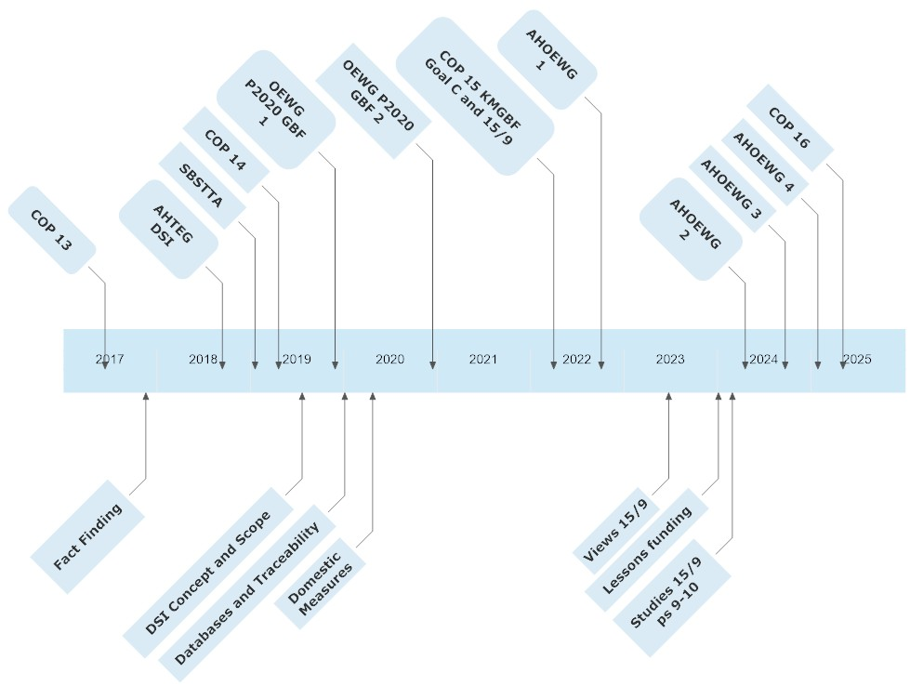
collections

Slide 51
IAG, Informals, OEWG DSI 4 (August), COP 16 (December)
6 meetings of Informal Advisory Group (zoom), OEWG DSI 4: August
Covered: Data governance, research methodologies, associated traditional knowledge, collaboration with FAO and WHO
Coming up: Non-monetary benefit sharing, disbursement of funds, fund and mechanism governance, host (not GEF), meeting requirements of 15/9 paras 6-10, compatibility with CBD and the Nagoya Protocol, and trigger points for contributions (who pays?)
https://www.cbd.int/dsi-gr/iag-2024.shtml
Hybrid approach and compatibility with Nagoya

Slide 52
Global Multilateral Benefit-Sharing Mechanism GMLBSM
DB Deposit Requirements
[origin]
Hybrid Approach
Nagoya
FPIC & MAT
Principles of data governance (ORDG)
Funds distributed as projects
F&E IP & LC Participation in Governance
Fair distribution
of projects
New genetic materials acquired from IP or LC territories or collections form these lands under Nagoya
Triggers
following digitalization
Raising funds
Researchers
1% on commercial sales
Voluntary contributions
endemic
species
genes
Non-monetary Benefits

Slide 53
Principles of Data Governance
Promoting Open and Responsible Data Governance (ORDG)
Databases of DSI should be open as possible, but closed as necessary to protect:
privacy
biosafety
biosecurity
human security
human rights, including those of Afrodescendents
public safety
Biocultural labels or biocultural metadata
Including standard fields in DSI databases that can link to data about Afrodescendant beliefs, values and aspirations related to the species

Slide 54
Principles of Data Governance
Promoting Open and Responsible Data Governance (ORDG)
Suggesting the establishment of a “Global Sacred Heritage List” of Species for which special considerations or prohibitions to their sequencing would apply
“VIrtual” – does not require a bureaucracy or many funds
Small list: Sacred species should only be those widely known (e.g. ayahuasca, Sangre de Dios)
Each region would nominate a few, well-known species as a symbolic measure
Cap on around 100-200 species globally, out of 10-20 million species
Purpose would be to generate awareness, discussions, recognition and promotion of rights and implementation of data governance principles
It would be supplemental to other measures

Slide 55
Principles of Data Governance
Promoting Open and Responsible Data Governance (ORDG)
Working with businesses and database operators to explore potential principles we could agree on
Can also include agreements about need for prior informed consent for collecting from ancestral lands
Indigenous and local community experts at an informal meeting organized by the Meridian Institute will propose principles of data governance

Slide 56
Global Multilateral Benefit-Sharing Mechanism GMLBSM
DB Deposit Requirements
[origin]
Hybrid Approach
Nagoya
FPIC & MAT
Principles of data governance (ORDG)
Funds distributed as projects
F&E IP & LC Participation in Governance
Fair distribution
of projects
New genetic materials acquired from IP or LC territories or collections form these lands under Nagoya
Triggers
following digitalization
Raising funds
Researchers
1% on commercial sales
Voluntary contributions
endemic
species
genes
Non-monetary Benefits

Slide 57
Relationship with the CBD and Nagoya Protocol
Since all DSI is created from somewhere
Since consent is required for access
No DSI should be generated from GRs that are protected or any future access without prior informed consent (PIC)
Once digital sequence data are in databases, they would operate by ORDG principles
If there is evidence that a sample has been acquired without consent, consent has to be obtained or the sample removed from the database

Slide 58
Relationship with the CBD and Nagoya Protocol
If an endemic gene is discovered that could only have come from Afrodescendent lands, then consent must be obtained
Otherwise, all information about that sample should be removed from DSI databases, and researchers should not use these data even if downloaded prior to removal
This right applies only to removal of samples containing GRs without consent
Need to monitor and assess provenance, or source of origin to determine if consent has been maintained, unlikely to happen as a COP 16 decision, as many Parties oppose mandatory disclosure of origin requirements

Slide 59
Global Multilateral Benefit-Sharing Mechanism GMLBSM
DB Deposit Requirements
[origin]
Hybrid Approach
Nagoya
FPIC & MAT
Principles of data governance (ORDG)
Funds distributed as projects
F&E IP & LC Participation in Governance
Fair distribution
of projects
New genetic materials acquired from IP or LC territories or collections form these lands under Nagoya
Triggers
following digitalization
Raising funds
Researchers
1% on commercial sales
Voluntary contributions
endemic
species
genes
Non-monetary Benefits

Slide 60
Means of raising funds (trigger points for obligations)
Several potential trigger points for requiring benefit sharing have been identified:
License fee at the research level, such as an annual subscription
Measuring annual commercial benefits from the use of DSI and giving a percentage of that (1%) of the fund
Taking annual net profits at the corporate level, and requiring 1% to the global biodiversity fund

Slide 61
Global Multilateral Benefit-Sharing Mechanism GMLBSM
DB Deposit Requirements
[origin]
Hybrid Approach
Nagoya
FPIC & MAT
Principles of data governance (ORDG)
Funds distributed as projects
F&E IP & LC Participation in Governance
Fair distribution
of projects
New genetic materials acquired from IP or LC territories or collections form these lands under Nagoya
Triggers
following digitalization
Raising funds
Researchers
1% on commercial sales
Voluntary contributions
endemic
species
genes
Non-monetary Benefits

Slide 62
Governance of the Mechanism
Governance of the Mechanism (overall system, including funding and data)
Governance of the Fund (criteria, allocation, distribution of project money)
Governance of data (ORDG)
May or may not be merged into single governance system, or kept separate
Permanent members with equal status
Permanent members with different status, for example:
Observers with equal rights to speak or intervene and participation decisions
Observers as observers with rights to speak or intervene, but not to take decisions
Observers as observers without rights to speak or intervene
Roles may also depend on the size of the Governance committee: large size could mean representation from all regions of the world, a small size (usual) would mean fewer and perhaps rotating membership

Slide 63
Global Multilateral Benefit-Sharing Mechanism GMLBSM
DB Deposit Requirements
[origin]
Hybrid Approach
Nagoya
FPIC & MAT
Principles of data governance (ORDG)
Funds distributed as projects
F&E IP & LC Participation in Governance
Fair distribution
of projects
New genetic materials acquired from IP or LC territories or collections form these lands under Nagoya
Triggers
following digitalization
Raising funds
Researchers
1% on commercial sales
Voluntary contributions
endemic
species
genes
Non-monetary Benefits

Slide 64
Non-monetary Benefit Sharing (NMBS)
The trigger point or points raise money for a fund that is used for projects
In addition to raising funds, the Mechanism may also find ways of sharing non-monetary benefits
Existing NMBS focuses on bilateral benefit sharing models under Nagoya
NMBS proposed still reflects this: technical training, capacity building, equipment donation, technology transfer, etc. – in-kind benefit sharing where companies in a contract are competent to share
In the multi-lateral system, NMBS can come from a much wider range of sources, including actions governments can take to do more than technology transfer, actions philanthropists can take
Reducing harms, recognition and effective enforcement of rights, involvement of women and youth, participation in governance can be NMBS

Slide 65
Conclusions
The Multilateral Benefit Sharing fund is meant to capture research and corporate utilization of genetic resources that have been converted into DSI
IIFB views it as additional to the Nagoya Protocol, not undermining it
Much of the advice to Parties is already developed and presented to Parties, although more needs to be do to clarify details (e.g. specify principles of data governance, or a process to develop them)
Adding to terminology in the decisions at COP 16 may be difficult. It is a new term, and may take years to develop (adding “Peoples” took 5 years). This may have to be developed at a higher level (CBD) rather than the Mechanism, which is subsiduary
Large role of Afrodescendents in getting Parties from their regions to adopt the positions of the IIFB, or to develop and / or add your own

